Slide 1
Chasing traits
Approaches to decoding the genome

Slide 2
Main idea:
- Identify natural variation in traits
- Find genomic features correlated with this variation
Disclaimer:
All these methods provide only correlative evidence!
To go from “candidate gene list” to a conclusion that a locus is really involved in trait determination can be a very long road.
Good start: combine several lines of evidence
Approaches:
GWAS
QTL mapping
Admixture mapping
Genome scanning

Slide 3
Before we start: it all makes sense only of the trait is heritable
Broad-sense heritability:
proportion of variation explained by who the parents were (or by clonal identity)
Narrow-sense heritability:
2x fraction of variation explained by who the daddy was.
(can also be measured from parent-offspring regression and from difference in correlation between monozygotic vs. dizygotic twins)

Slide 4
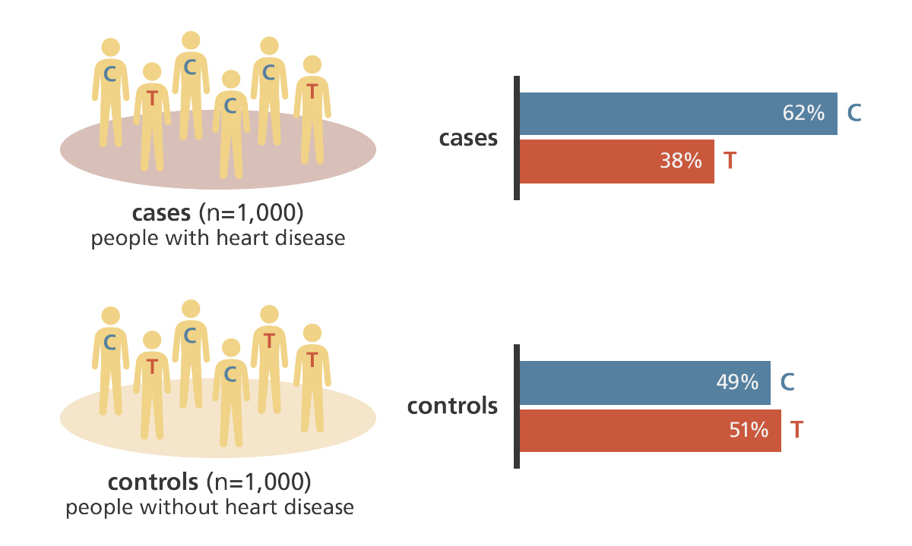
GWAS

Slide 5
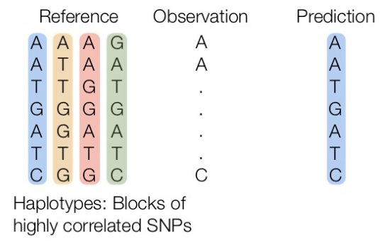
GWAS:
imputation based on known haplotypes: no need to keep resequencing everyone!
What determines how sparsely can you genotype a creature to be able to impute its whole genome?

Slide 6
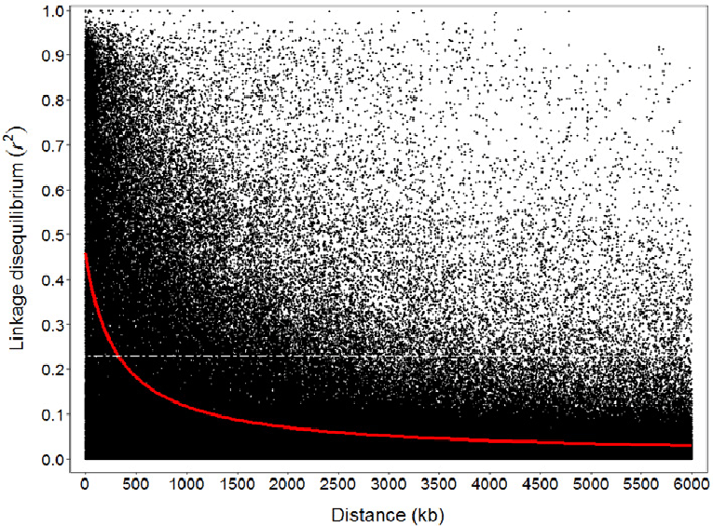
GWAS:
imputation based on known haplotypes
What determines how sparsely can you genotype a creature to be able to impute the whole genome?

Slide 7
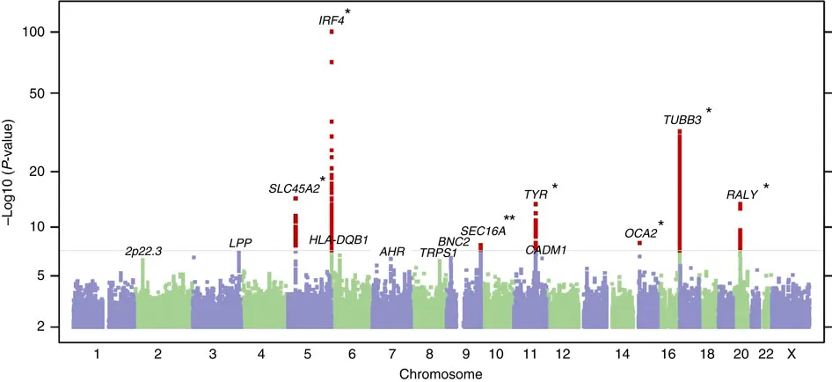
GWAS: Manhattan plot
cutaneous squamous cell carcinoma

Slide 8
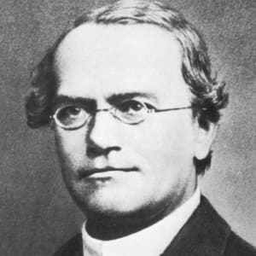
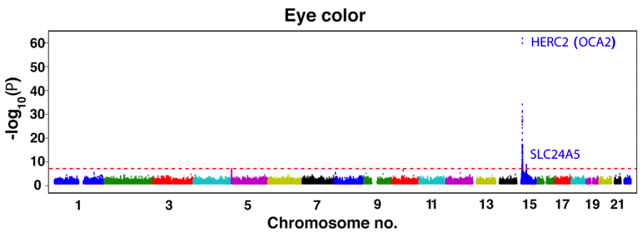
GWAS
How NIH hoped it would work:
“blue eyes gene”

Slide 9
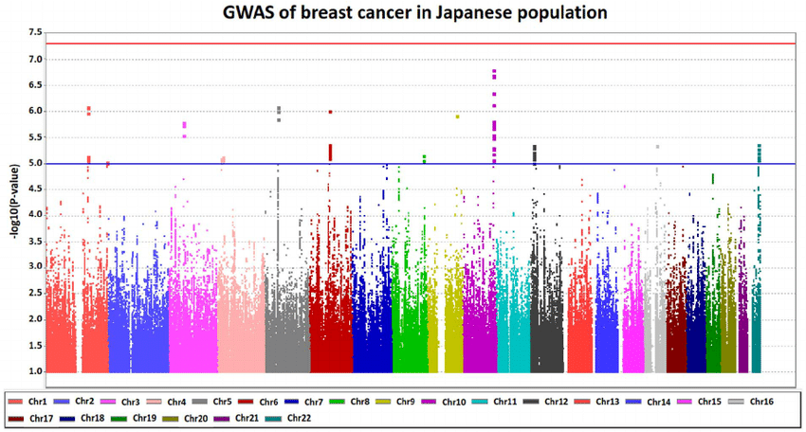
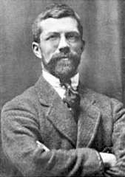
X
GWAS
- Continuum of association strengths at many SNPs – POLYGENIC TRAIT
- Even the best variants accounting only for small fraction of heritability
- Population-specific (which is not necessarily bad!)
R. A. Fisher

Slide 10
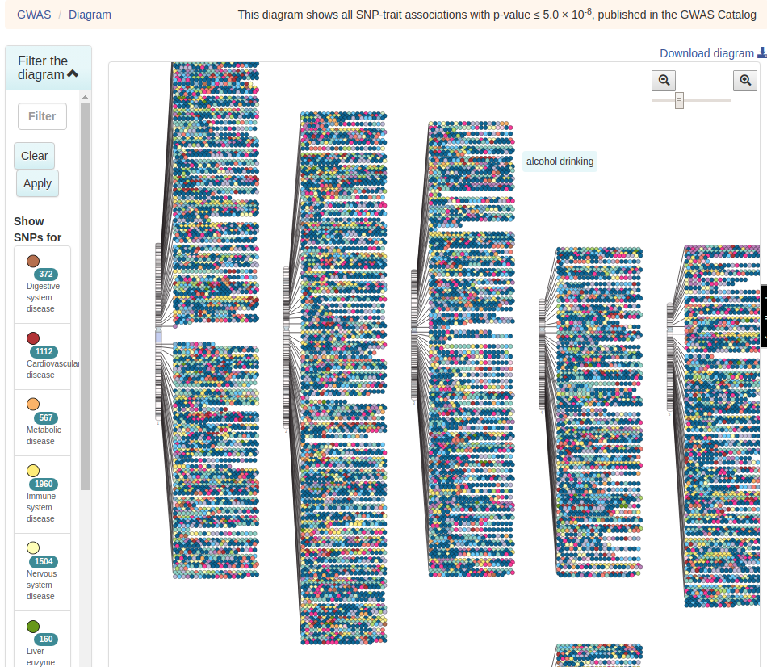
GWAS
https://www.ebi.ac.uk/gwas/diagram

Slide 11
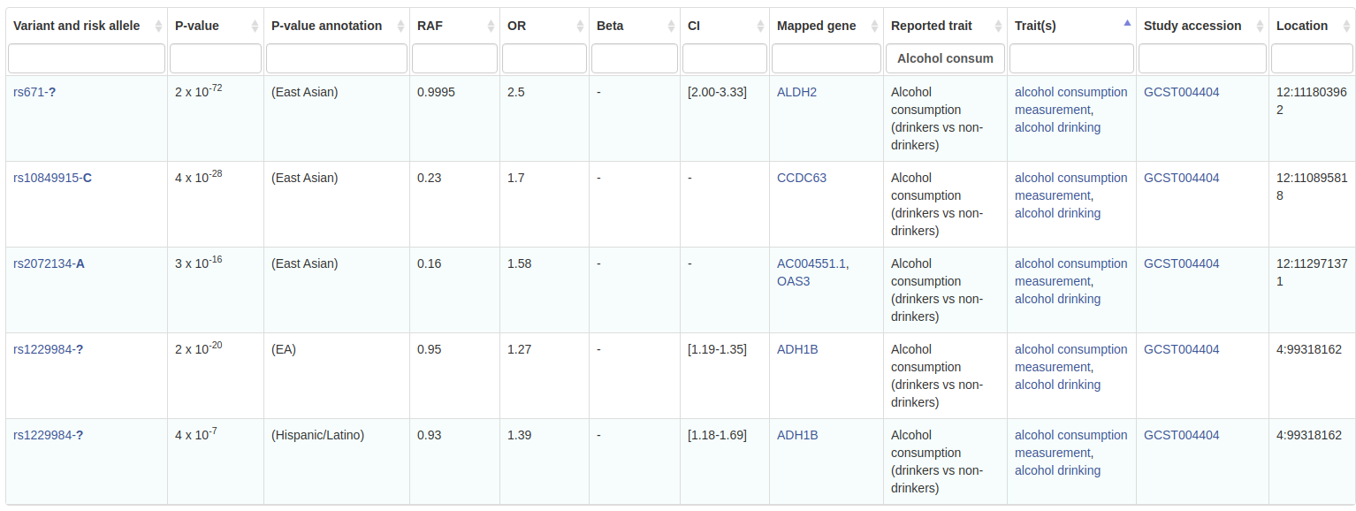
GWAS
OR: odds ratio (for categorical traits)
OR = (A:drinkers/A:non-drinkers ) / (a:drinkers/a:non-drinkers)
OR = 2 ⇒ risk allele carriers are twice more likely to start drinking than people without risk allele
https://www.ebi.ac.uk/gwas/efotraits/EFO_0004329

Slide 12
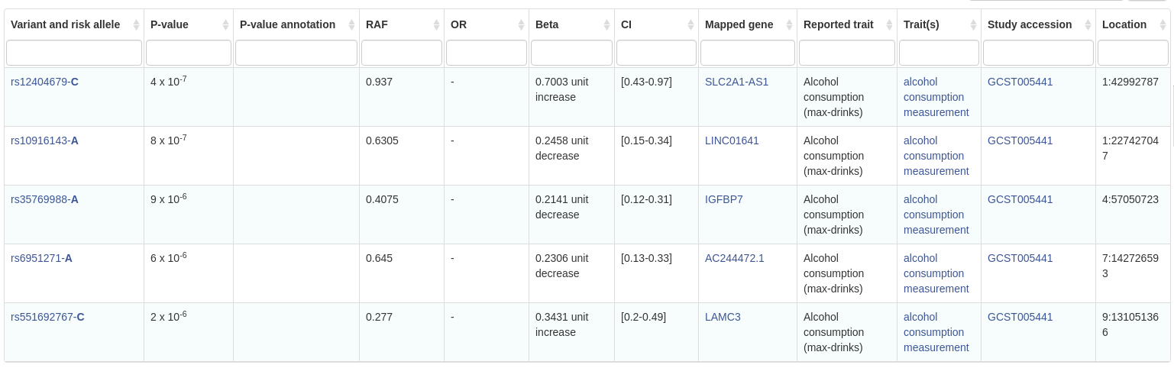
GWAS
Beta: effect size (for continuous traits)
Change in trait in individuals carrying risk allele compared to non-risk allele carriers
https://www.ebi.ac.uk/gwas/efotraits/EFO_0007878

Slide 13
GWAS difficulties
- small-effect alleles (the majority) can only be detected with huge sample sizes (10⁴+)
- must control for possible population structure!
- if most of our cases (drinkers) are Russians and most controls (non-drinkers) are Persians, we will detect a LOT of “drinking-associated” SNPs that simply distinguish Russians from Persians but have no relation to drinking, specifically.
- Either sample from the same population, or use population as covariate in the GWAS model.
- what if population structure is unknown? Determine it from the data! (later in the class)

Slide 14
X
GWAS
- Continuum of association strengths at many SNPs – POLYGENIC TRAIT
- Even the best variants accounting only for small fraction of heritability
- Population-specific (which is not necessarily bad!)
R. A. Fisher

Slide 15
GWAS
Polygenic Score (PGS): to predict the trait in a new sample, sum up the effect sizes (Betas) of all observed SNPs (significant or not)
PGS SNPs are chosen after “LD clumping” (choose best SNP, remove all SNPs in LD with it, repeat for next-best remaining SNP etc.)
How to calculate PGS for a categorical trait (based on ORs?)

Slide 16
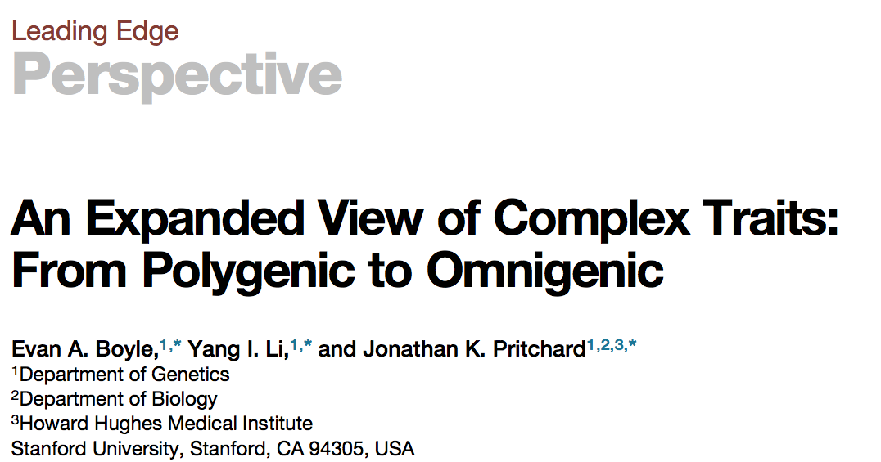

Slide 17
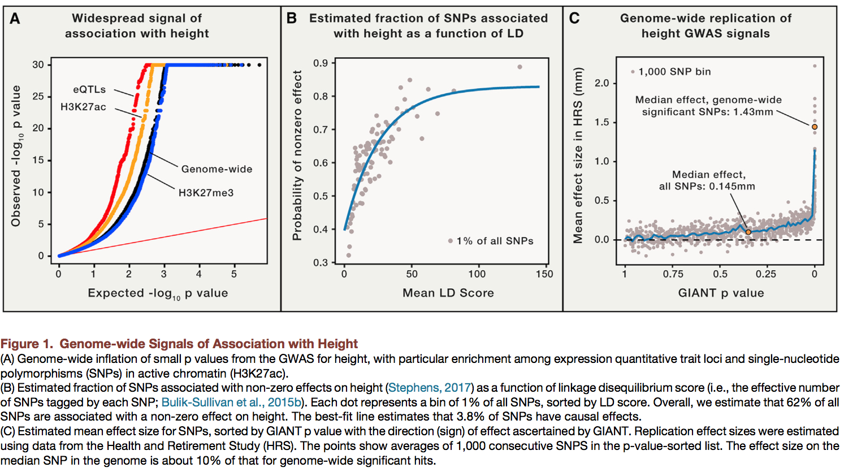

Slide 18
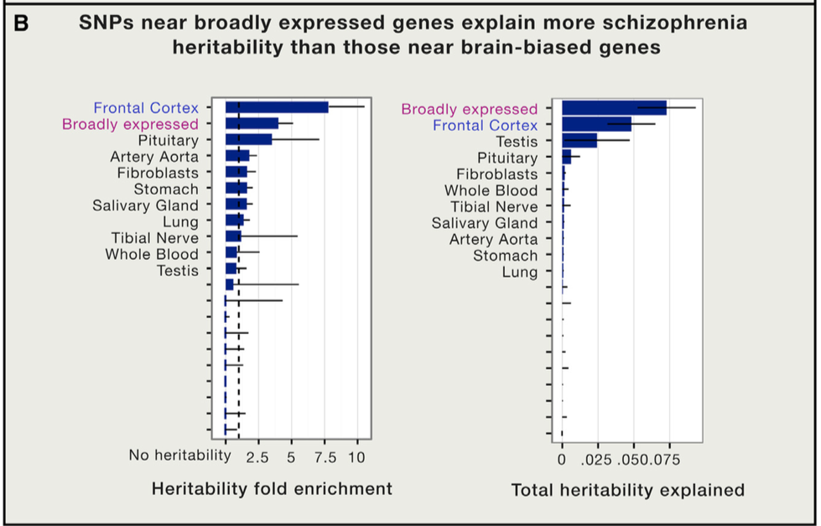
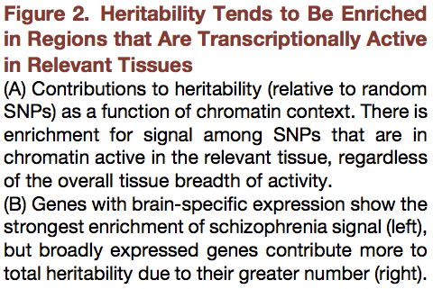

Slide 19
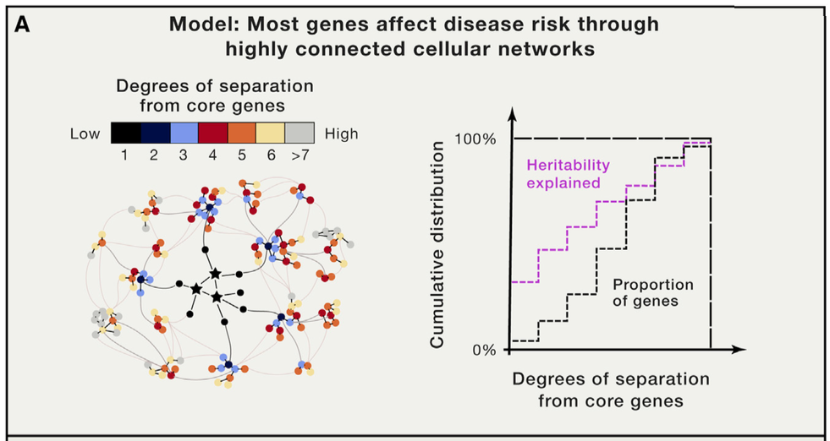
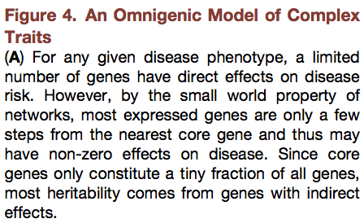

Slide 20
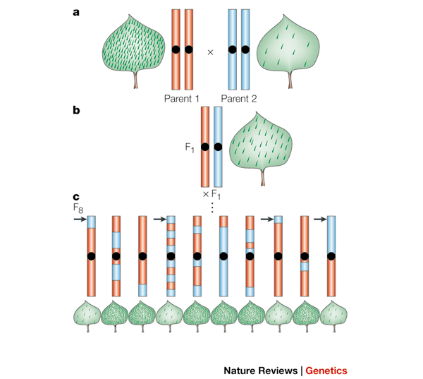
QTL mapping
Just like GWAS, but the mapping population is a progeny of single parental pair
Pros:
Very powerful, trait-associated regions are much easier to detect
Needs very few markers
Cons:
in most cases, signals are specific to the chosen parents (i.e. cannot fully answer “what makes trait vary in natural populations”)
Low genomic resolution (unless either very many individuals are genotyped, or advanced F generation is used)

Slide 21
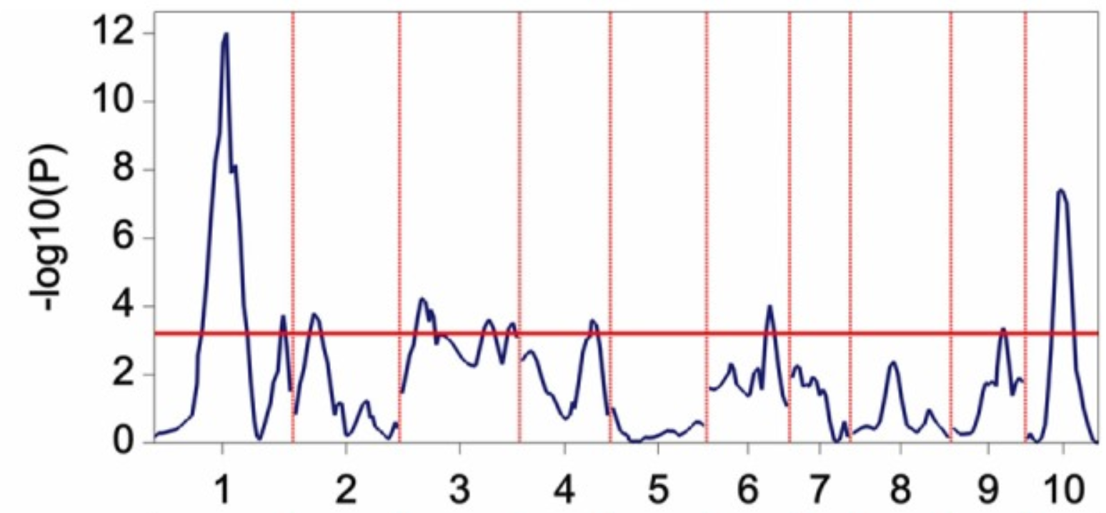
QTL mapping
Just like GWAS, but the mapping population is a progeny of single parental pair (or just a few parents)
Pros:
Very powerful, trait-associated regions are much easier to detect
Needs very few markers (why?)
Cons:
in most cases, signals are specific to the chosen parents (i.e. cannot answer “what makes trait vary in natural populations”)
Low genomic resolution (unless very many individuals are genotyped)

Slide 22
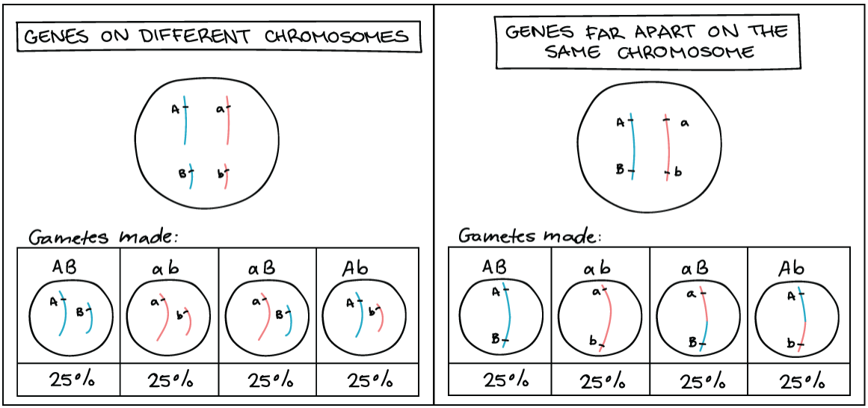
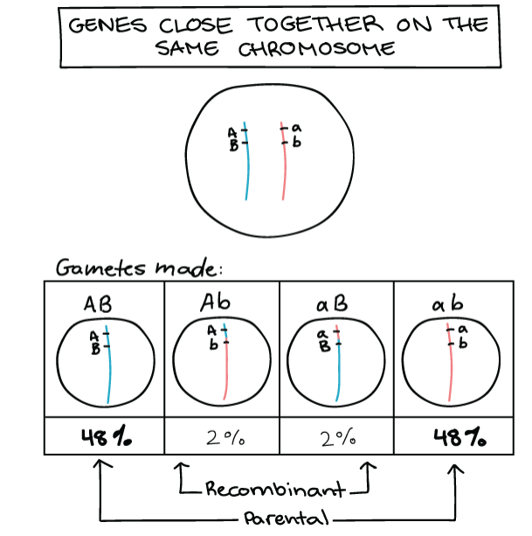
Linkage map construction
In QTL mapping, don’t need a genome!
Determine relative position of markers based on observed frequency of recombination among them

Slide 23
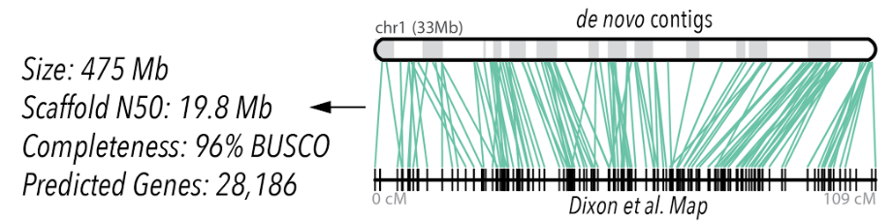
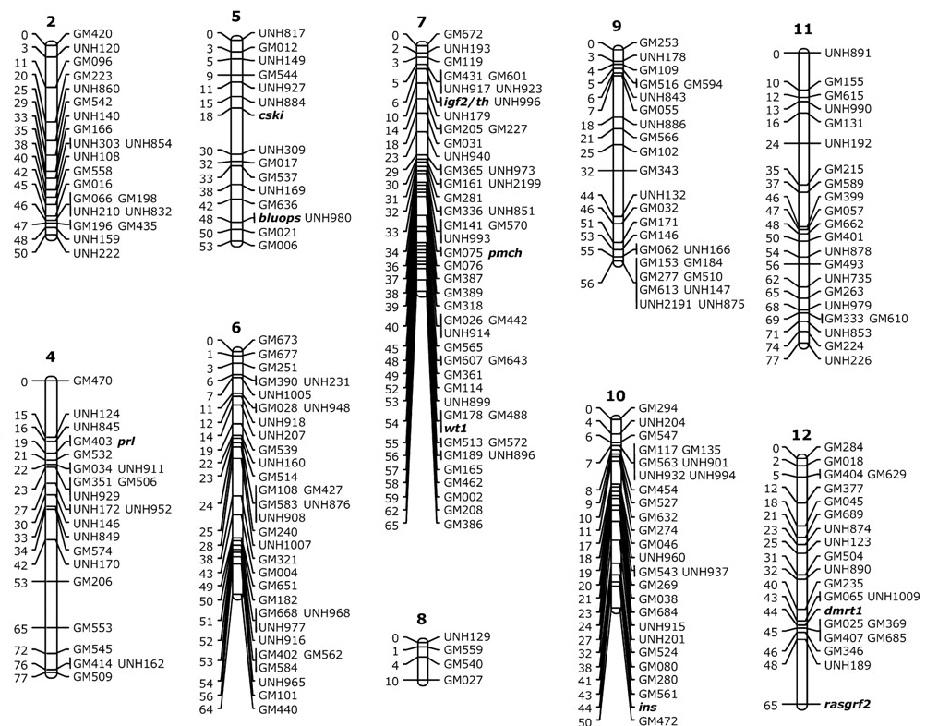
Linkage map
Super-useful for genome assembly!

Slide 24
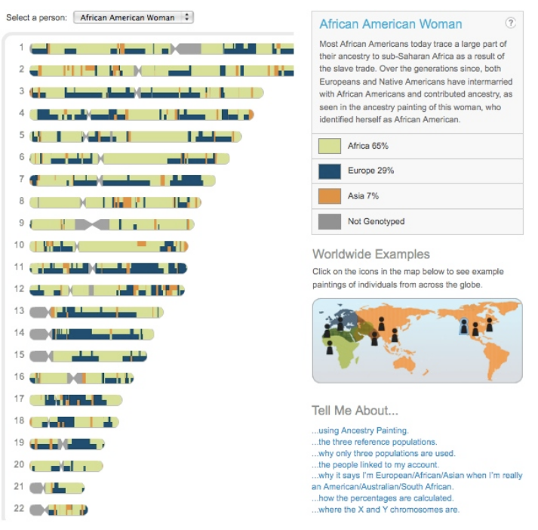
Admixture mapping
Mapping population is admixed, have two easily identifiable ancestry types (e.g., African-Americans)
Intermediate between GWAS and QTL mapping in terms of power:resolution tradeoff.
Like GWAS, characterizes natural population (not just one pair of parents)

Slide 25
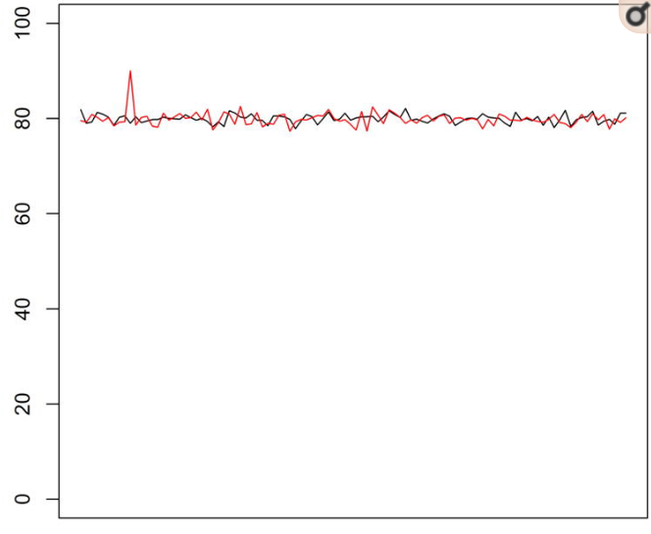
Admixture mapping
Mapping population is admixed, have two easily identifiable ancestry types (e.g., African-Americans)
Intermediate between GWAS and QTL mapping in terms of power vs. resolution tradeoff.
Like GWAS, characterizes a natural population (not just one pair of parents)
% African ancestry
cases
controls
Where can we (“non-human” people) use this approach?
What type of sequencing would you choose?
position along chromosome
Notes:
https://www.ncbi.nlm.nih.gov/pmc/articles/PMC3556814/

Slide 26
Genome scanning
Searching for signatures of natural selection in the genome
- two or more differentially adapted populations
- one population (used in highly-genotyped models, e.g. humans) - see previous lecture!
Pro: directly addresses genomic basis of adaptation in nature
Cons:
Hard to disentangle selection-driven patterns from neutral variation and noise
Best if multiple pairs of populations are compared

